Slide 1
Cryptocurrency Sentiment & Trading Analysis
Nick Baronti, Jeri LaCson, Ryan Keen, & Tina Calvin
February 26, 2022

Slide 2



AGENDA
1. Project Objectives
2. Updated Data Extraction (Binance)
3. Data Manipulation & Cleanup
4. NLTK Sentiment Analysis
5. Crypto Entry/Exit Point Analysis
6. Key Takeaways

Slide 3
Project OBJECTIVES
Update API to extract historical crypto prices from Binance US exchange.
Refresh crypto portfolio dashboard with latest historical prices (hourly).
Extract most relevant news articles for each crypto using the News API.
Analyze sentiment of each crypto in portfolio using NLTK (VADER).
Create trading algorithm to track potential entry & exit points for all cryptos. Analyze each cryptos performance and compare to sentiment.

Slide 4

CCXT LIBRARY:
CryptoCurrency eXchange Trading library
The CCXT library is used to connect and trade with cryptocurrency exchanges and payment processing services worldwide.
It provides quick access to market data for storage, analysis, visualizations and algorithmic trading.
Binance US API:
Used the Binance US exchange API to extract Open, High, Low, Close, Volume (OHLCV) historical crypto data for the last 1,000 hours.
Extracted hourly data for more precise entry & exit point analysis.
https://github.com/binance-us/binance-official-api-docs
Data extraction
(API)

Slide 5

OHLCV HISTORICAL DATA:
Used for loop to loop through list of top 50 cryptocurrencies and extract OHLCV data using CCXT & Binance
Used try & except to determine base currency denomination (i.e., BUSD, USDT, USDC, UST) for each cryptocurrency
Used TQDM function to show a progress bar loading crypto data
Appended crypto price data to a list and then converted into Pandas DataFrame
CUSTOM ALTCOIN PORTFOLIO:
Created custom portfolio of altcoins selecting 6 of the top 50 cryptocurrencies (non-bitcoin)
Established variables for initial total investment, portfolio weights, & number of days invested
Created function to determine the units invested in each crypto as of the initial investment date
Created custom Pandas dataframes of portfolio data to use for interactive charts, plots, and Monte Carlo simulations
Data manipulation & cleanup

Slide 6

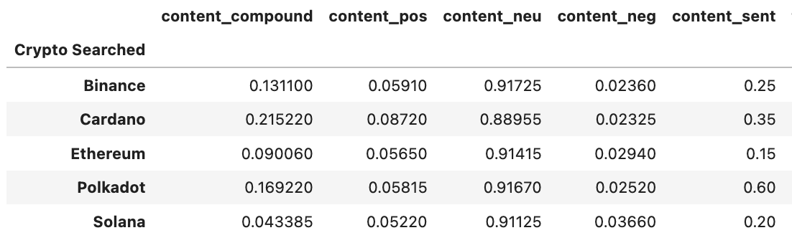
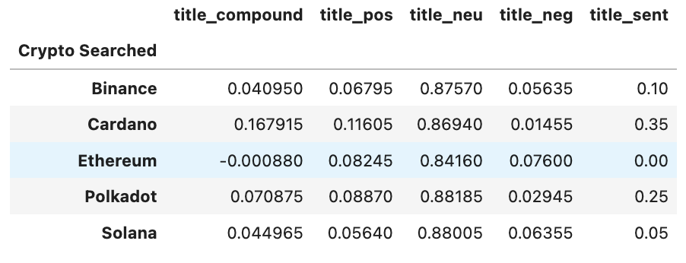
VADER SENTIMENT ANAYSIS:
Used Vader Lexicon Sentiment Intensity Analyzer.
Polkadot (DOT) scored the highest in terms of content score.
Cardano (ADA) scored the highest in terms of title score.
Ethereum (ETH) scored the lowest in terms of content score and title score.
NLTK Sentiment Analysis

Slide 7

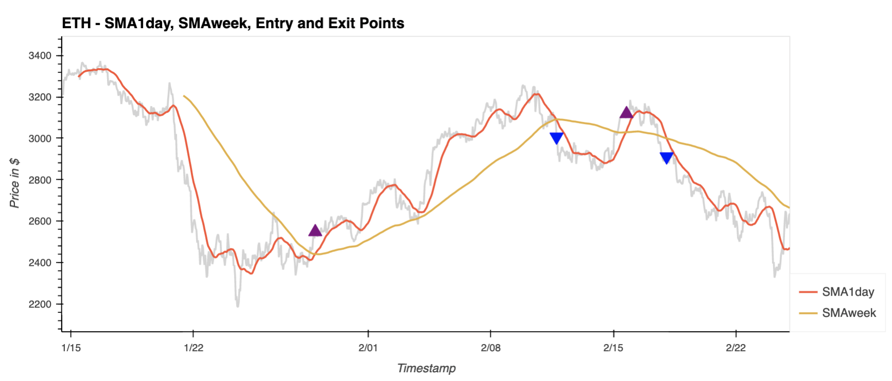
CRYPTO SMA CHART ANALYSIS:
Created DataFrame for each crypto with 1-day and 1-week simple moving average (SMA) calculations.
Created algorithm to track entry & exit points for each cryptocurrency based on the two SMAs crossing each other.
1-day SMA > 1-week SMA = Bullish (Enter)
1-day SMA < 1-week SMA = Bearish (Exit)
Crypto
Entry & Exit
Point
Analysis

Slide 8

CRYPTO ENTRY/EXIT POINT CHARTS USING ALGORITHM BASED ON 1-day SMA & 1-Week SMA.

Slide 9
ETH Entry & Exit Point Chart
Title Sentiment Score | 0.00
Content Sentiment Score | 0.15
Lowest Sentiment Scores

Slide 10
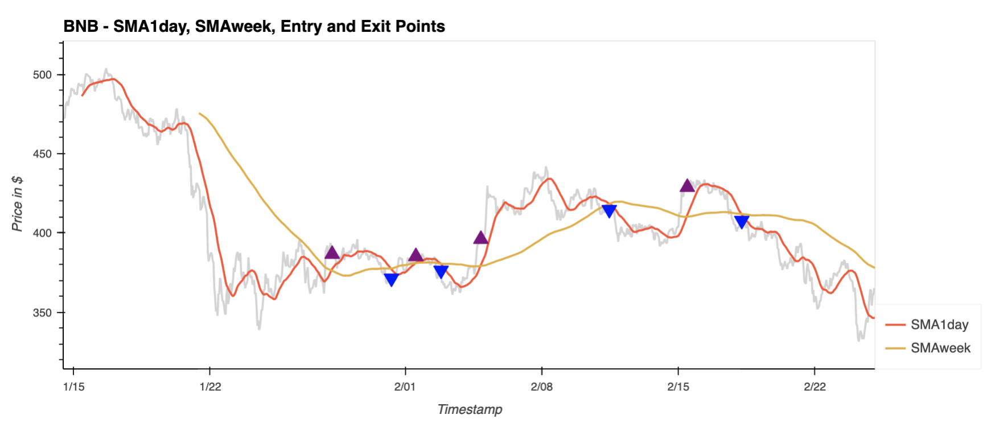
BNB Entry & Exit Point Chart
Title Sentiment Score | 0.10
Content Sentiment Score | 0.25

Slide 11
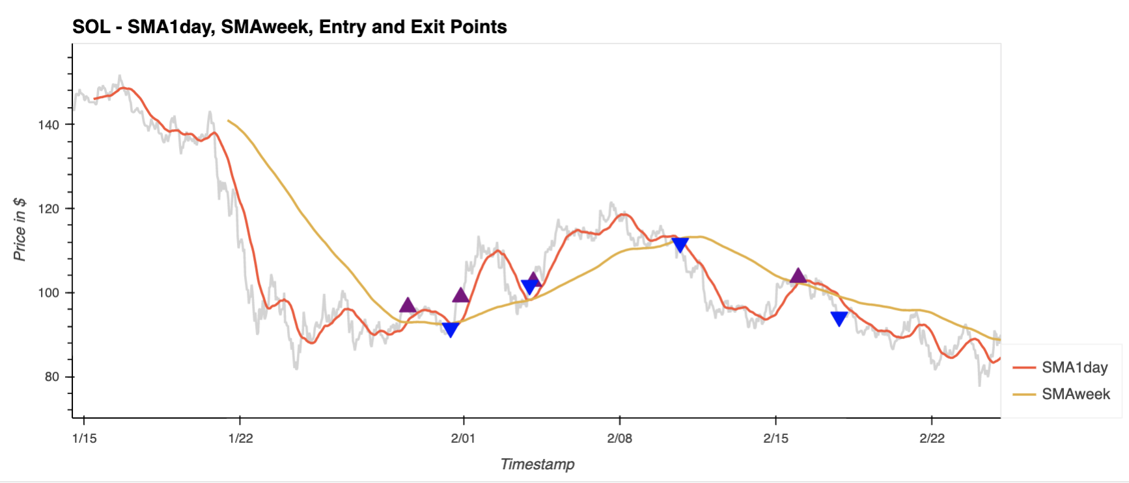
SOL Entry & Exit Point Chart
Title Sentiment Score | 0.05
Content Sentiment Score | 0.20

Slide 12
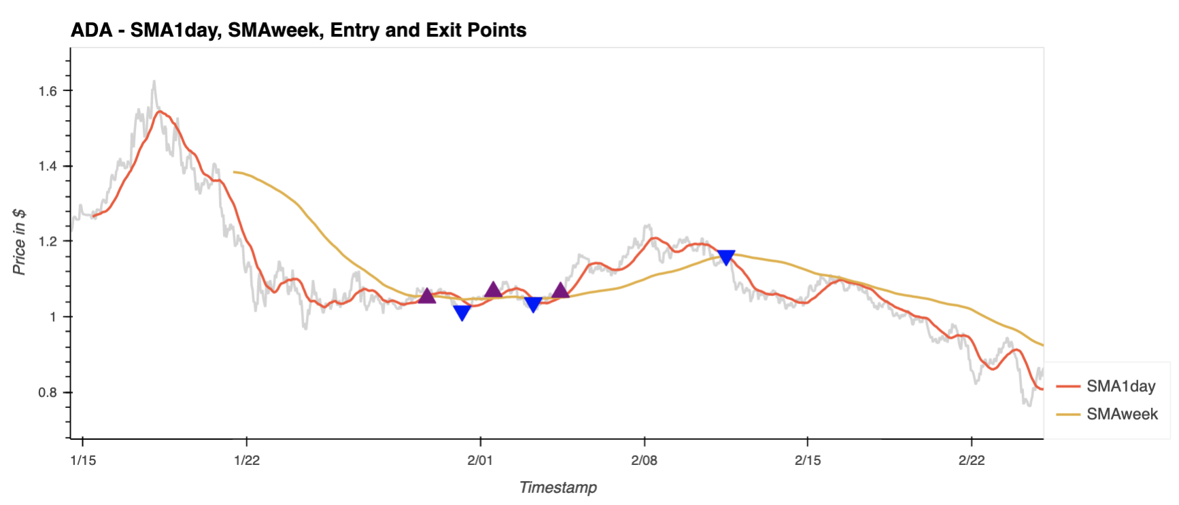
ADA Entry & Exit Point Chart
Title Sentiment Score | 0.35
Content Sentiment Score | 0.35
Highest Title Sentiment Score

Slide 13
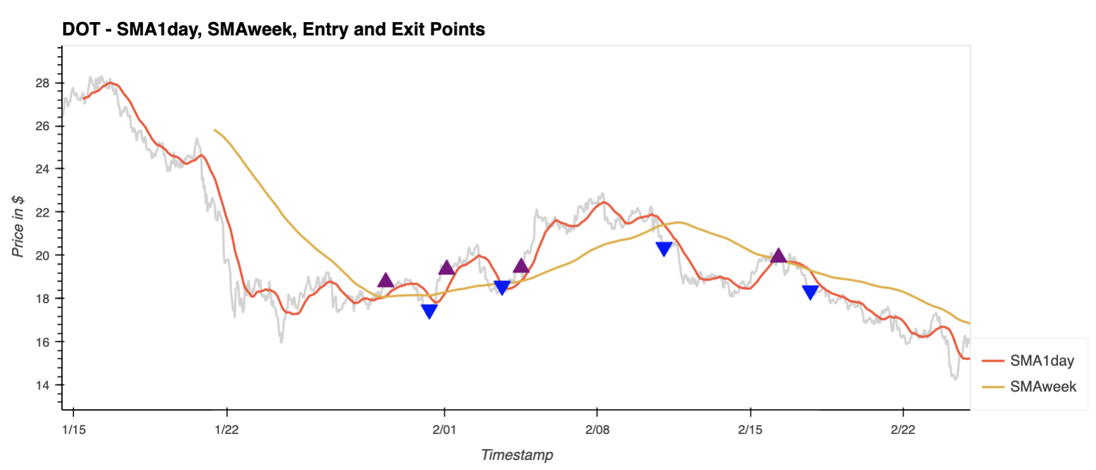
DOT Entry & Exit Point Chart
Title Sentiment Score | 0.25
Content Sentiment Score | 0.60
Highest Content Sentiment Score

Slide 14
KEY TAKEAWAYS FROM ANALYSIS
No meaningful impact when looking at positive sentiment coins and implementing a trading strategy around 1-day and 1-week SMA price intersections.
Ethereum had the lowest sentiment score but ultimately would have had the largest potential profit from its first two trades.
For most other coins in the portfolio, the algorithm would result in majority losses.
Key
Takeaways
~$400 upside per ETH

Slide 15
Data & Calculations | APIs | Packages
1. Data extraction via Binance US exchange (using CCXT) | Binance US API | Numpy, Pandas, TQDM, Hvplot, Matplotlib
2. Sentiment Analysis on 6 cryptos within portfolio dashboard | News API | NLTK, JSON, Pandas
3. Pick top 3 best sentiment scores (compound score on article & title) | N/A | NLTK, Pandas
4. Build entry & exit point chart analysis for each of the 6 cryptos within the portfolio dashboard | N/A | Custom functions, Hvplot

